Slide 1


Coin Market Analysis using Web Scraping & EDA
Presented by:
Durga, Varsha, Mourya
Batch No : 474

Slide 2

Introduction
Problem Statement
The cryptocurrency market contains thousands of digital assets, each with unique price movements and trading behavior. Due to the large volume of data, it becomes challenging to identify patterns and trends manually.This project focuses on analyzing cryptocurrency market data using Exploratory Data Analysis (EDA) techniques. By examining price distributions, market capitalization, and trading volume patterns, we aim to uncover meaningful insights about the cryptocurrency market.
Why this Project?
The dataset used in this project was collected from an online cryptocurrency market platform through web scraping techniques.
Instead of relying on pre-existing datasets, the data was gathered directly from the website to simulate a real-world data collection process similar to industry-level data science workflows.
This approach allows us to work with real-time financial market data, making the analysis more practical and meaningful.

Slide 3
Dataset Information
Dataset: coin_market_analysis
Source: coinmarketcap.com
Description: The dataset contains information about different cryptocurrencies and their market performance.

Slide 4





Tools & Libraries Used:

Slide 5
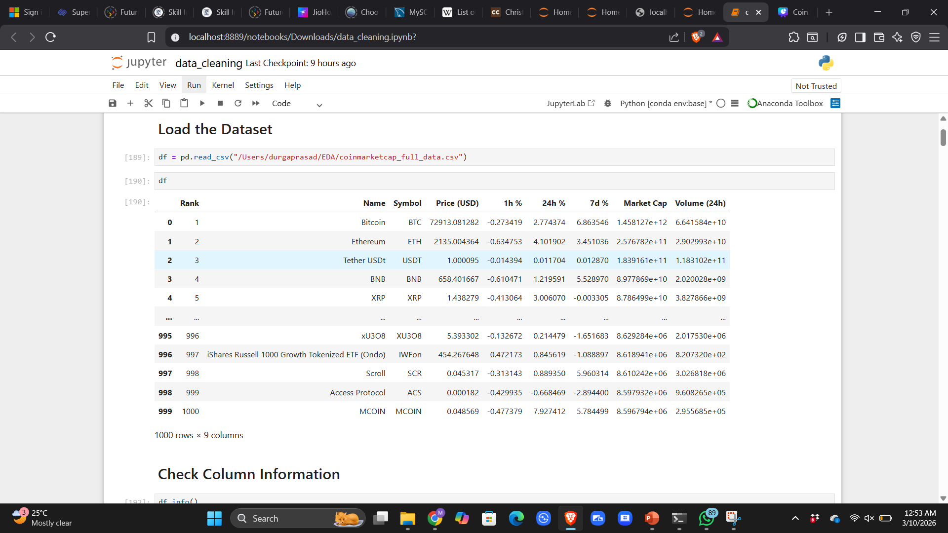
Raw Dataset

Slide 6
DATA COLLECTION – API Based Web Scraping
API Scraping
The cryptocurrency dataset was collected from the CoinMarketCap website, which provides real-time information about digital asset markets.
Cryptocurrency rank
Cryptocurrency name
Trading symbol
Price (USD)
Percentage price changes (1h, 24h, 7d)
Market capitalization
24-hour trading volume

Slide 7
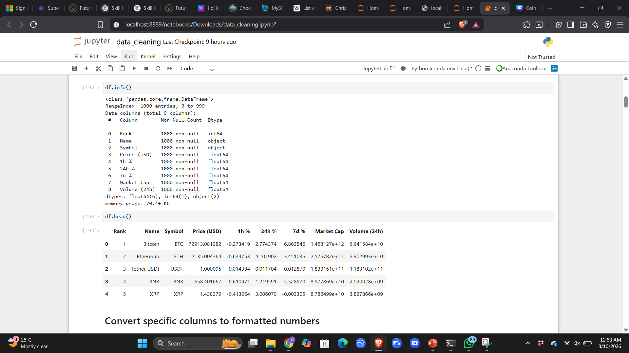
Dataset Overview
The dataset contains:
1000 cryptocurrency records
9 columns representing key market metrics
Rank
Name
Symbol
Price (USD)
Hour %
Day %
Week %
Market Cap
Volume (24h)

Slide 8
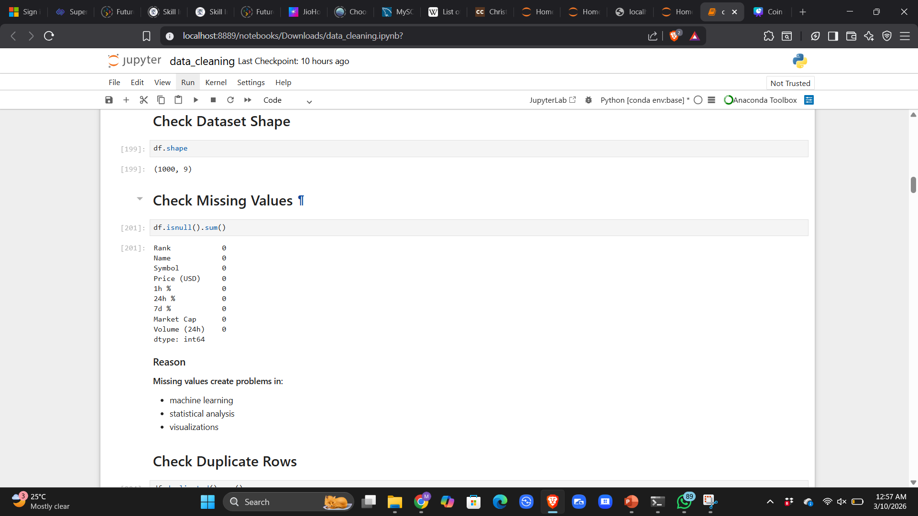
DATA CLEANING
Data Quality Check
The dataset was checked for:
Missing values
Duplicate rows
Incorrect data types
Formatting inconsistencies
This step ensures the reliability and usability of the dataset.
Observation
After performing data quality checks:
No missing values were found across the dataset.
No duplicate rows were detected.
All numerical columns were successfully converted into numeric formats.

Slide 9
DATA VISUALIZATION

Slide 10
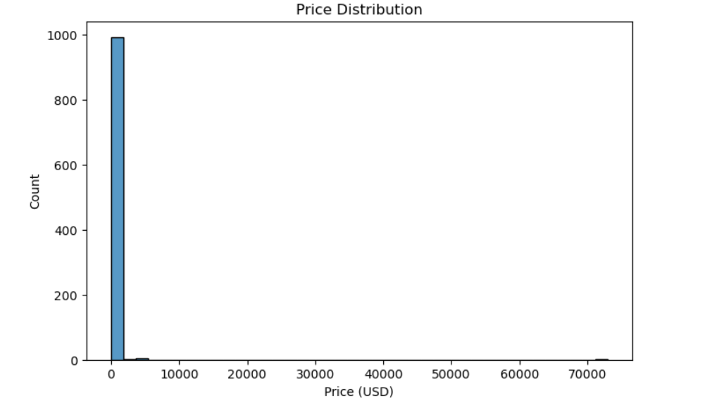
EDA – Univariate Analysis
1. What is the distribution of cryptocurrency prices in the dataset?
Observations:
The distribution of cryptocurrency prices is highly right-skewed.
Most cryptocurrencies have very low prices compared to a few high-value coins.
Only a small number of cryptocurrencies such as Bitcoin and Ethereum dominate the high price range.

Slide 11
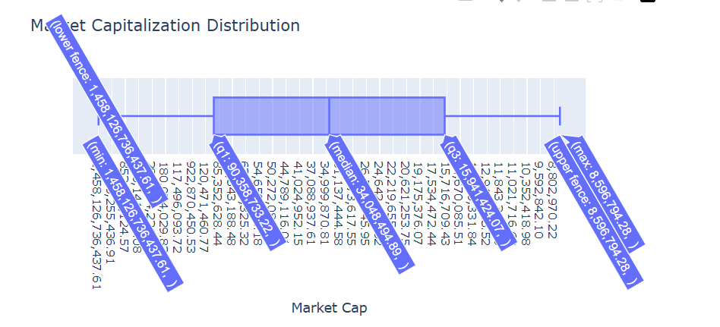
EDA – Univariate Analysis
Which cryptocurrencies have the highest market capitalization?
Observations:
A small group of cryptocurrencies contribute to the majority of the total market capitalization.
Top ranked cryptocurrencies such as Bitcoin, Ethereum, and other major coins dominate the market.
Many smaller cryptocurrencies have significantly lower market caps.

Slide 12
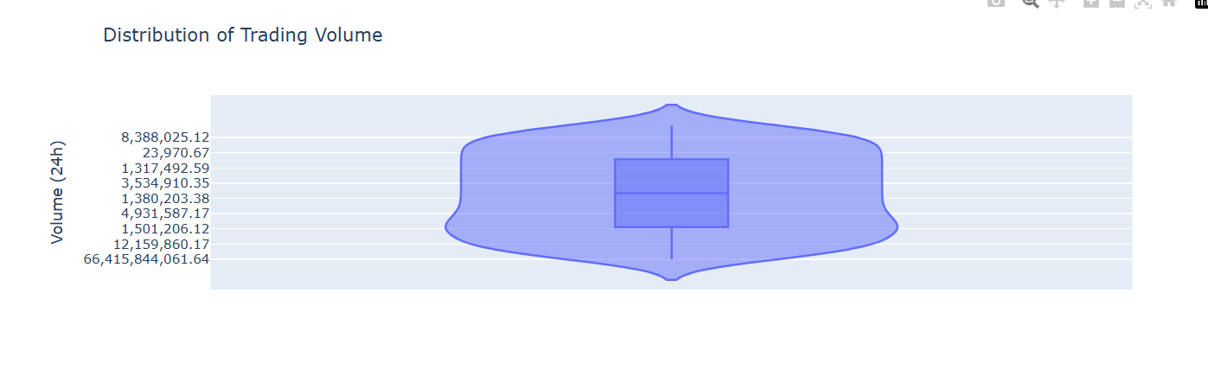
EDA – Univariate Analysis
How is trading volume distributed among cryptocurrencies?
Observations:
Trading volume shows a right-skewed distribution.
A few cryptocurrencies have very high trading activity.
Most cryptocurrencies have relatively lower trading volumes.

Slide 13
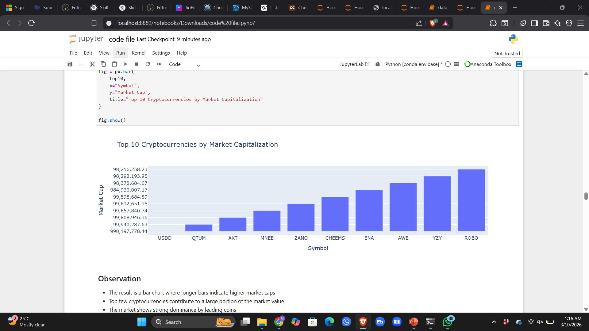
EDA – Bivariate Analysis
4. How does market capitalization influence cryptocurrency ranking?
Observations :
Cryptocurrencies with higher market capitalization usually have better rankings.
Lower ranked cryptocurrencies tend to have significantly smaller market caps.

Slide 14
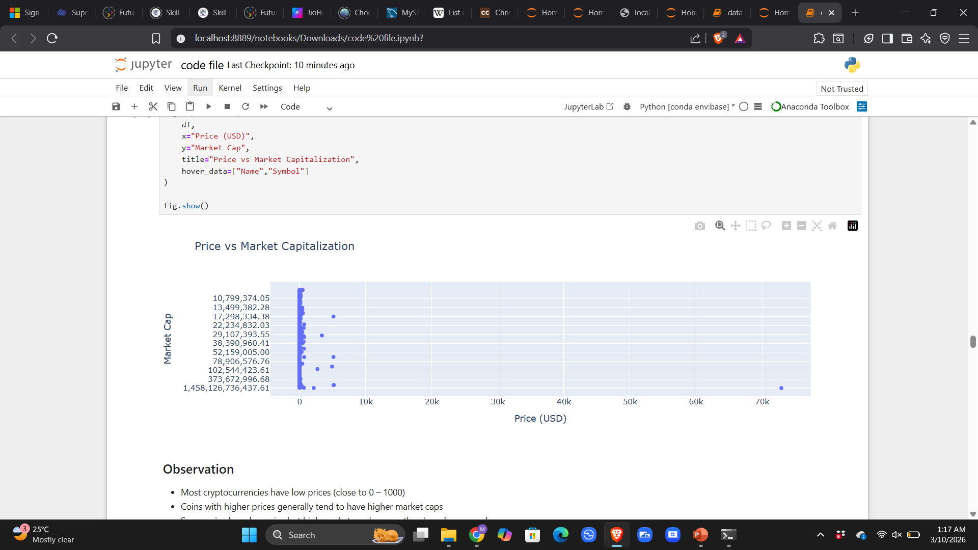
EDA – Bivariate Analysis
6. How do price and market cap interact?
Observations :
Cryptocurrencies with higher prices often have larger market capitalizations.
However, market cap also depends on circulating supply, not just price.

Slide 15
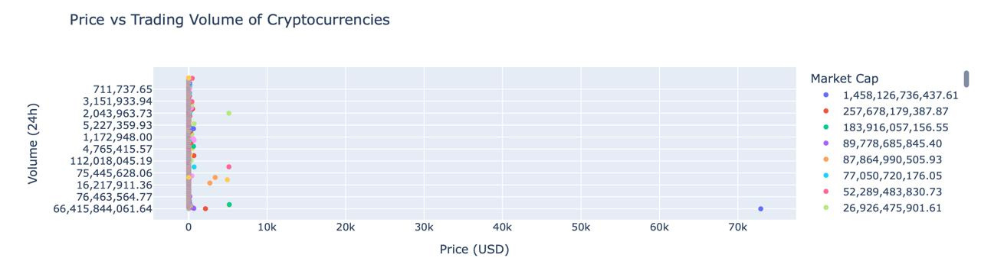
EDA – Bivariate Analysis
5. How does price relate to trading volume?
Observations:
Some high-priced cryptocurrencies also show high trading volumes.
However, certain lower priced coins can still have large trading volumes due to popularity.

Slide 16
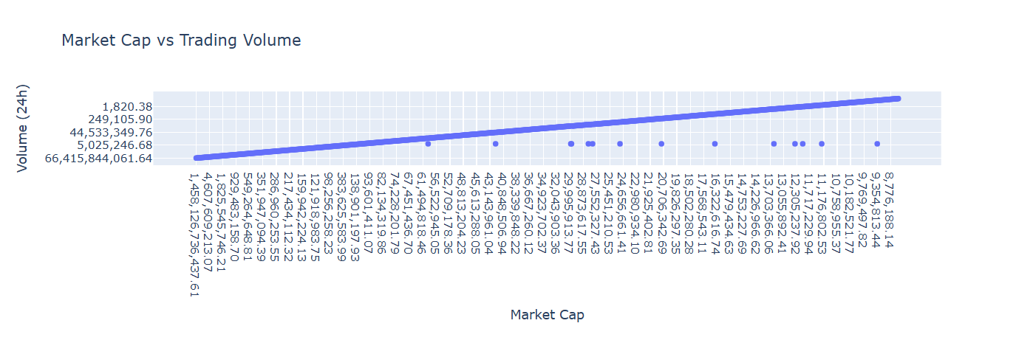
EDA – Bivariate Analysis
7.How does market capitalization relate to trading volume in the cryptocurrency market?
Observations:
Cryptocurrencies with higher market capitalization generally have higher trading volumes.
Top-ranked cryptocurrencies dominate both market cap and trading activity.
Some lower-ranked cryptocurrencies show moderate trading volume despite smaller market caps, indicating active market interest.

Slide 17
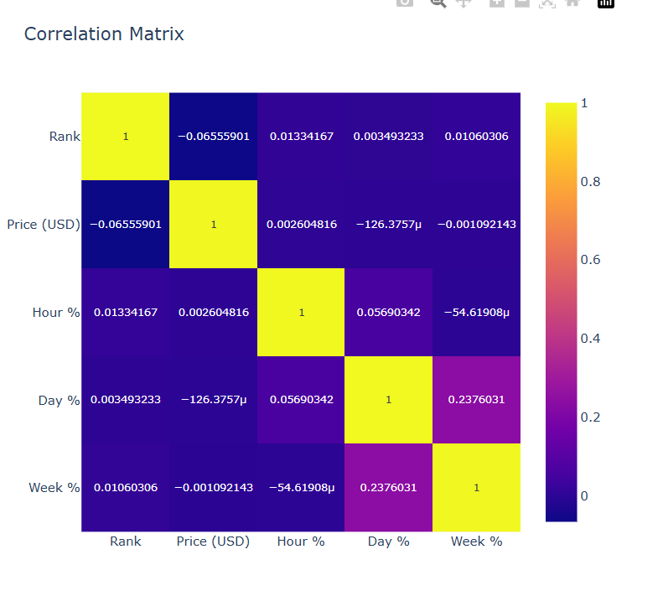
EDA – Multivariate Analysis
8. Which variables show strong relationships with each other?
Observation:
Market cap shows moderate correlation with price and trading volume.
Hourly, daily, and weekly percentage changes show short-term market volatility patterns.
No extremely strong correlations exist among most variables.

Slide 18
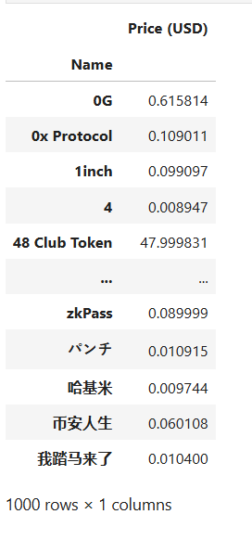
EDA – Pivot Tables
Which cryptocurrencies have the highest average price?
Observations:
A small number of cryptocurrencies have significantly higher average prices.
Most cryptocurrencies have relatively low prices compared to top coins.

Slide 19
🏁 Final EDA Conclusions
The cryptocurrency market is dominated by a few major digital assets.
Most cryptocurrencies fall within the lower price range.
Trading volume is concentrated among popular cryptocurrencies.
Price changes show high volatility in short time intervals.
Market behavior is influenced by multiple interacting factors.

Slide 20
🏁 Final Project Summary
This project analyzed cryptocurrency market data using Exploratory Data Analysis techniques.
Key steps included:
Collecting market data through web scraping
Cleaning and preprocessing the dataset
Performing exploratory analysis
Identifying trends and patterns in cryptocurrency prices

Slide 21

THANK YOU

